Slide 1
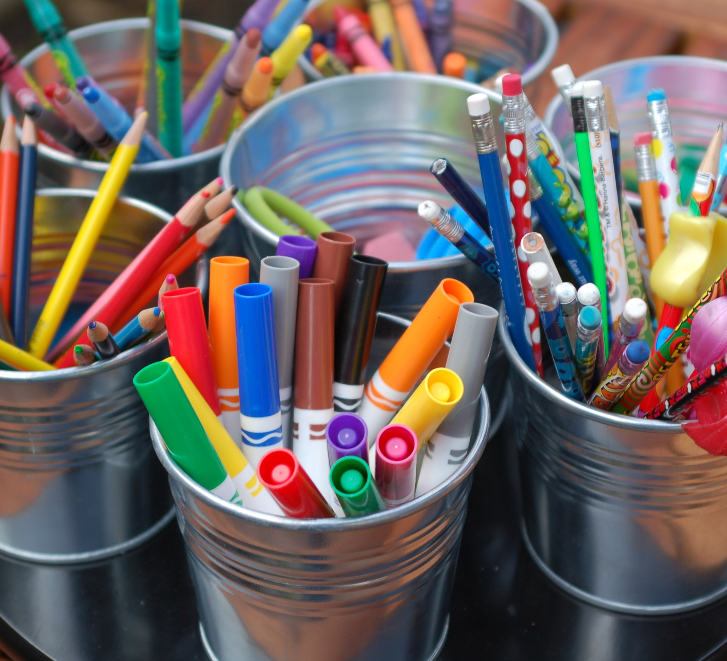
Welcome to Primary 3!

Slide 2
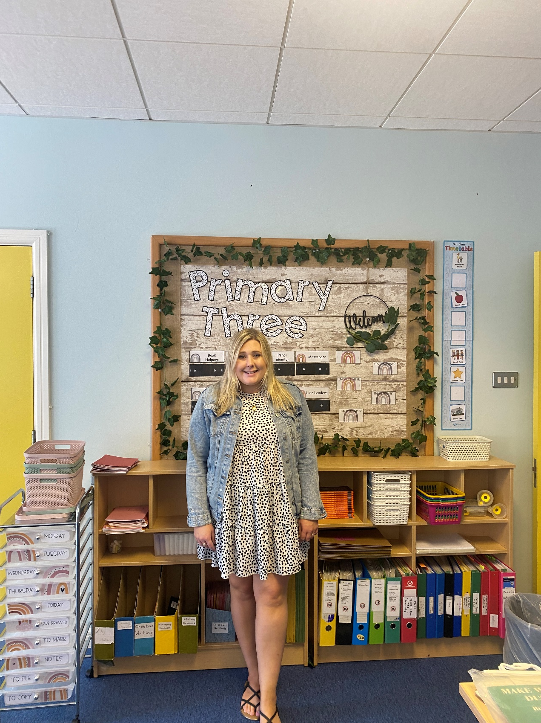
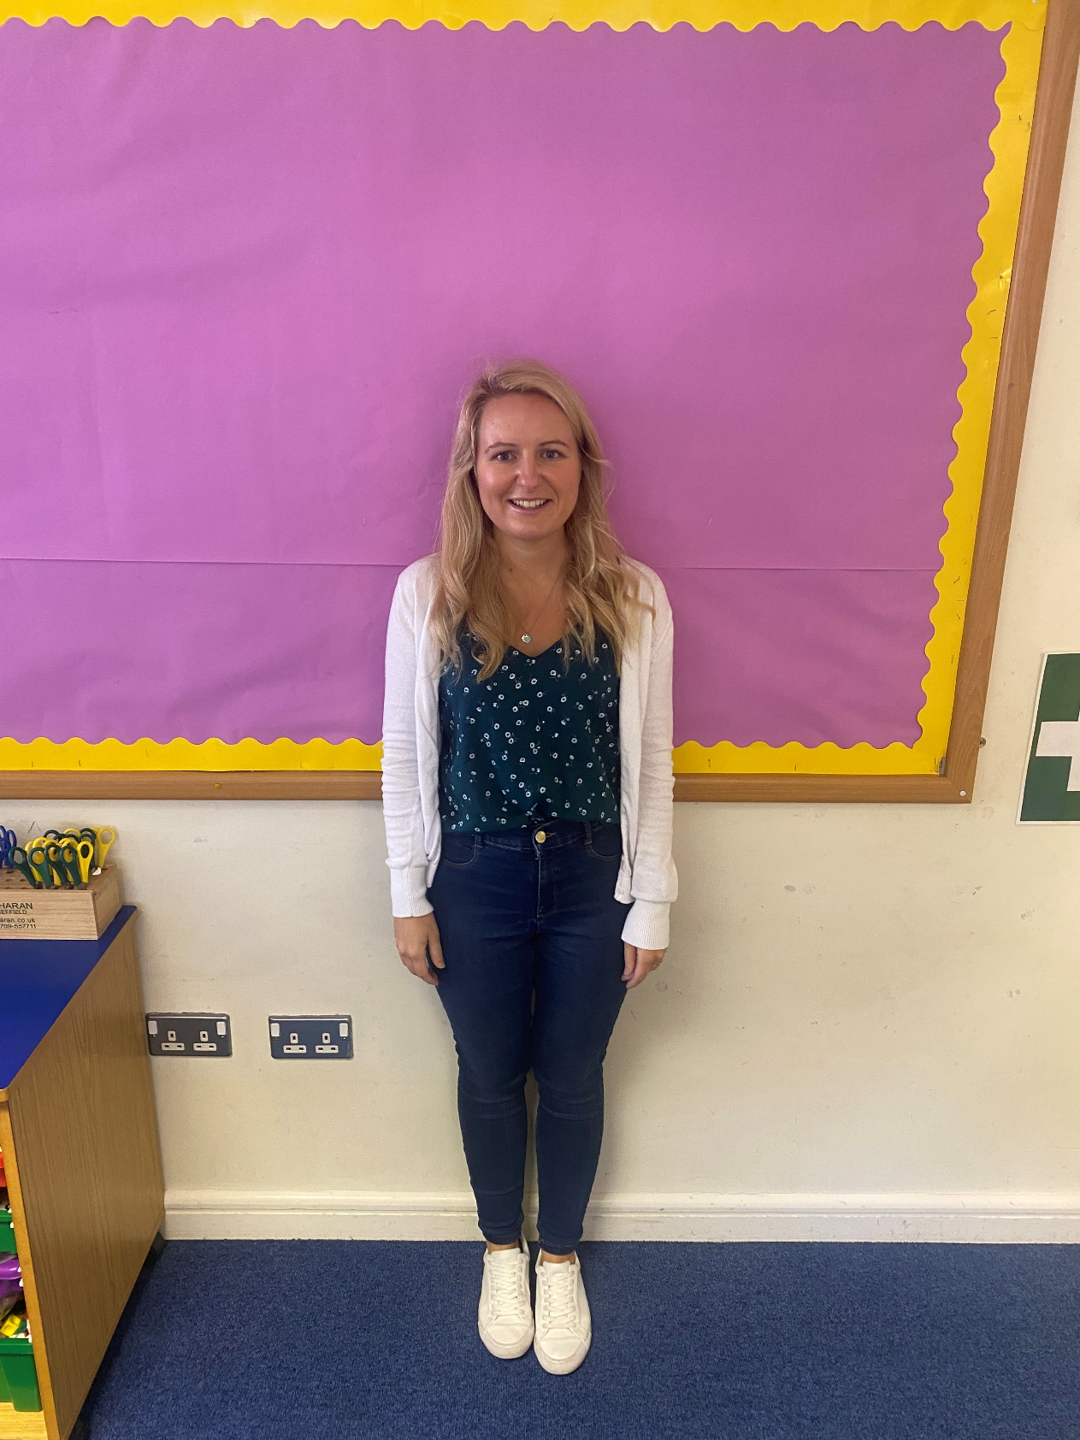
Welcome to Primary 3! We are going to be your teachers this year.
This PowerPoint contains information about the P3 year and what to expect.
Miss McCluskie – P3M
Mrs Armstrong – P3A

Slide 3
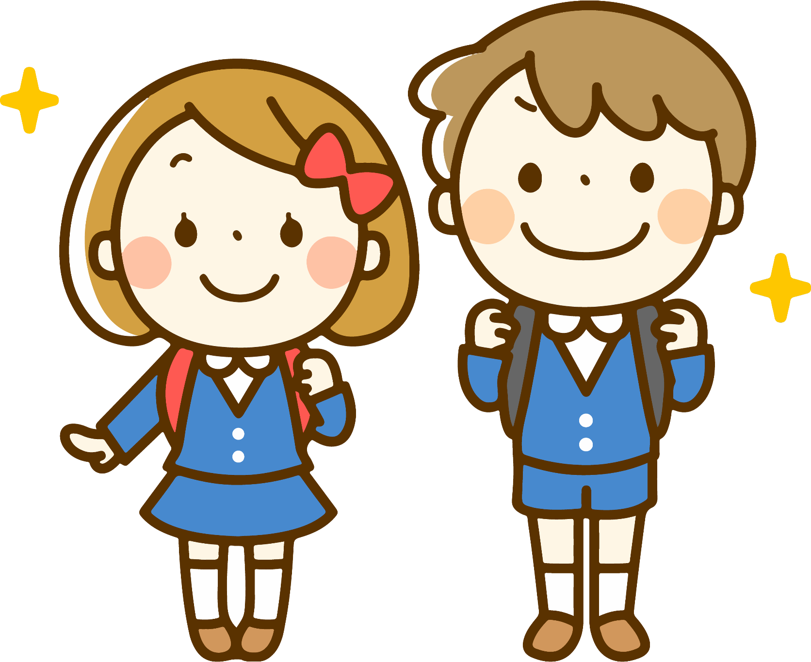
General Information:
Forms – Permission forms will all be completed online, apart from a blue data form for new pupils which will need completed at home and a hard copy returned to your child’s class teacher. https://forms.office.com/r/LMHriz638s
If you are eligible for free school dinners you must complete the free school dinners form online. This refreshes each school year, so if your child had free school dinners last year, you will still need to complete the form for this year again. Forms can be found here: Apply for Free School Meals / Uniform Grants | Education Authority Northern Ireland (eani.org.uk).
Please put names/initials on all of your child’s belongings and uniform.

Slide 4
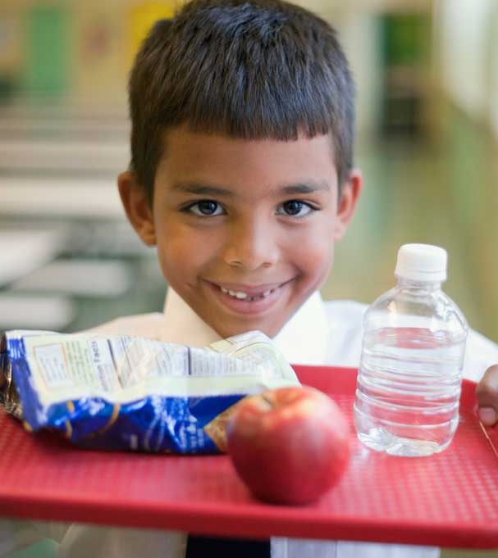
General Information Continued
Break/Lunch – Break is eaten in the classroom and lunch served in the canteen. Hot meals will be available for school dinners. Sign up for dinners for the week before Sunday midnight.
NO NUTS – we are a nut free school so please do not send anything containing nuts.
Break – please send in one or two small snacks for break.
Promote healthy eating. Treat day on a Friday.
Please do not send your child into school with toys, unless it is for show and tell or it has been arranged with the class teacher.

Slide 5
Drop off / Pick up
School will be open from 8.30am. P3 meet in the lower playground in the courtyard at Door 5. Your child’s class teacher will be outside to greet them. If the weather is bad, we will meet just inside the doors.
Teachers will wait outside with the class from 8.30 – 8.45am (weather permitting).
School work will begin at 9am so please ensure your child is in school before 9am.
Registration closes at 9am – children after this will be marked late and will need to come in through the front door. Any children coming into school after 9.30am will be marked absent for the morning session.
Children will be picked up from the same area at home time.
25th – 31st August children will finish at 11.50am.
From the 1st September, P3 home time will be at 2.45pm Monday and Tuesday; 1.45pm Wednesday – Friday.
P3 children must be picked up by an adult from the door.
If a child is late/absent due to sickness or an appointment, please let the class teacher know.

Slide 6
Homework Written homework will begin w/c Monday 5th September.
Monday : Spellings & Tables and Reading
Tuesday : Spellings & Tables and a written Literacy/Topic homework
Wednesday: Spellings & Tables and Digital Night (Mathletics)
Thursday: Revise spellings & tables for the Friday Test
Spellings & Tables booklets for the month will be sent home at the beginning of each month. Booklets should be kept at home until they are finished. They can be brought in at the end of each month. Each Friday we will have a Friday Test on that weeks spellings and mental maths that they have learnt at home. These will be linked to what we are doing in class.
The written literacy/topic homework each week will also linked to what we are doing in class to revise concepts. Written homework's will be sent home in a homework folder on a Friday for the following week and we ask that these are returned on the Wednesday. This allows for some flexibility if a Tuesday night does not suit your family for a written homework. Any written homework's returned late (after Wednesday) may not be marked due to turnaround time.
Friday Tests will be marked and sent home for parents to see. Please return these to school on the Monday.
Reading- Reading books will be sent home on a Friday and will be returned on a Wednesday with the Literacy homework. We recommend reading for a short time each night, but we know this may not always be possible so we encourage you to read with your child frequently when you can.
Mathletics – Children will complete Mathletics tasks online on Wednesday nights. These will be linked to areas of maths we will have covered in class.

Slide 7
Spellings, Tables & Friday Test
Children should write out Monday, Tuesday and Wednesdays spellings into their booklet using the look, cover, write method. Thursday night should be spent revising the week’s spellings for a Friday Test.
Tables should also be completed in the booklet and practiced mentally for Friday Tests.

Slide 8
Reading
The main scheme we use is “Storyworlds.”
We use other reading schemes including Harberton, Oxford Reading, Project X, Discovery World and Songbirds.
We have colour bands for books and read widely to broaden vocabulary.
The children study each book by reading the text both aloud and silently.
We discuss the story, illustrations and any issues arising.
We return to the text and discuss grammar and usage.

Slide 9
Reading – What can you do?
Encourage fluency and expression through reading out loud with your child.
Word attack skills with unfamiliar words – use context, phonics sounds, word beginnings/endings
Ask questions – make sure they have understood what they have read. Look to increase their vocabulary.
Join the library, read and share books at home.

Slide 10
Phonics and Spellings
We use a Linguistic Phonics approach – 15 minute sessions every day.
Practise Phonics – initial sounds, blends, rhyming words, word endings etc.
Remember – spelling is not just about spelling tests. The children must be able to spell words in their daily writing.

Slide 11
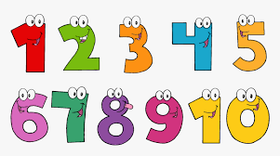
Numeracy In P3 children will….
Recognise numbers to 30, 50 and then 100
Use 100 square
Add and subtract up to 100 – horizontal and vertical
Read and use a calendar
Begin working with sets, counting in 2’s, 5’s and 10’s
Money – up to £1
Shape – 2D and 3D
Telling the time – analogue and digital
( hour, ½ hr and ¼ hour)
Measurement – length, weight and capacity.
Data Handling – a variety of graphs – Venn, Carroll, block, tally chart.

Slide 12
ICT In P3 children will…
Express: create and develop ideas using digital media
Exhibit: showing/ printing work
Evaluate: discuss their work
Explore: find and select information
Exchange: know that digital methods can be used to communicate

Slide 13
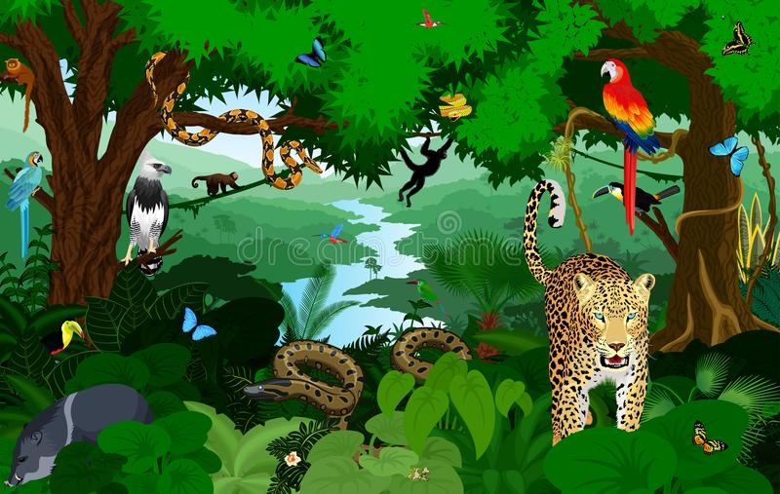
The World Around Us
This includes aspects of History, Geography and Science.
Literacy, Numeracy and ICT are often linked to Topics so that children can make connections with their learning.
Some of the topics we look at in P3 include; Ourselves, Rainforests & Animals, Cold Lands, House and Homes, Kings and Queens and Superhero's (people who help us).

Slide 14
Other learning areas
Music – loud/soft, high/low, slow/fast, listening, composing simple rhythms.
Drama – role plays, puppets, linked to topics and stories.
PE – dance, team games, athletics, gymnastics, ball skills. P.E. for P3 is on Tuesdays. Please bring gym shoes, shorts or tracksuit bottoms and a t-shirt.
This is only a flavour of the work covered in Primary 3.
School Trips:
Castle Espie – Animals and Birds (Brent Geese)
Ulster Folk and Transport Museum – Houses and Homes
Wee Critters - Rainforest

Slide 15
Behaviour and Rewards
Golden Time Ladder
Traffic Lights
Dojo Points
Table Points
House Points

Slide 16
Consultations
Progress is monitored throughout the year along with assessments in October and May.
Individual appointments to discuss your child’s progress will be held in October and March.
A written report will be sent home in June.
Other parent communication:
Brief conversations are permissible in the mornings at the designated areas. If longer is required you can make an appointment for after school hours.
Dojo will remain our main form of communication this year. Therefore it will be updated regularly with information and you can message your child’s teacher via Dojo as well.

Slide 17
Thank you for taking the time to read this.
We hope it has answered any questions you may have but please don’t hesitate to contact us if you have any more queries or worries.
We look forward to working with you and your child this year and we are excited for the year ahead ☺
Miss R. McCluskie and Mrs D. Armstrong

